Slide 1
Software Engineering Lab Week 6
Exercises 4.5, 6.7*, 7.1*, 7.2*, 7.3*, 7.4*, 4.7, 7.10*
* 8th edition

Slide 2
Exercise 4.5
Using the technique suggested here, where natural language is presented in a standard way, write plausible user requirements for the following functions:
■ An unattended petrol (gas) pump system that includes a credit card reader. The customer swipes the card through the reader and then specifies the amount of fuel required. The fuel is delivered and the customer’s account debited.
■ The cash-dispensing function in a bank ATM
■ The spelling-check and correcting function in a word processor

Slide 3
Excercise 6.7
Describe four types of non-functional requirements that may be placed on a system. Give examples of each of these types of requirement.

Slide 4
Excercise 7.1
Suggest who might be stakeholders in a university student records system. Explain why it is almost inevitable that the requirements of different stakeholders will conflict in some way.

Slide 5
Excercise 7.2
A software system is to be developed to manage the records of patients who enter a clinic for treatment. The records include records of all regular patient monitoring(temperature, blood pressure, etc.), treatments given, patient reactions and so on. After treatment, the records of their stay are sent to the patient’s doctor who maintains their complete medical record. Identify the principal viewpoints which might be taken into account in the specification of this system and organize these using a viewpoint hierarchy diagram.

Slide 6
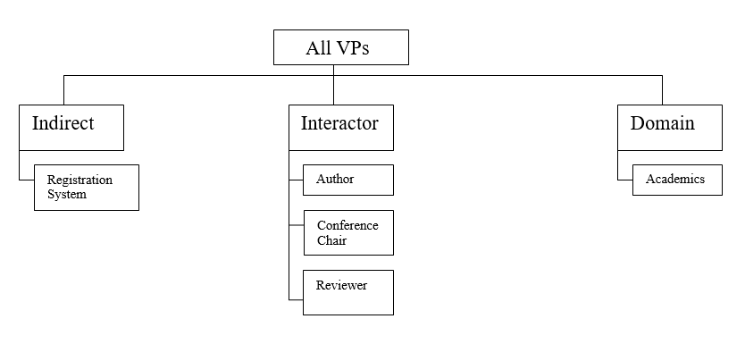
Excercise 7.3
For three of viewpoints identified in the conference system, suggest three requirements that could be suggested by stakeholders associated with that viewpoint.

Slide 7
Excercise 7.4
The LIBSYS system has to include support for cataloguing new documents where the system catalog may be distributed across several machines. What are likely to be the most important types of non-functional requirements associated with the cataloguing facilities?

Slide 8
Excecise 4.7
Using your knowledge of how an ATM is used, develop a set of use cases that could serve as a basis for understanding the requirements for an ATM system.

Slide 9
Excercise 7.10
Your company uses a standard analysis method that is normally applied in all requirements analyses. In your work, you find that this method cannot represent social factors that are significant in the system you are analysing. You point this out to your manager, who makes it clear that the standard should be followed. Discuss what you should do in such a situation.

